Slide 1
Calculi or uroliths (urolithiasis)
Kidney : nephroliths – nephrolithotomy
Ureter : ureteroliths – ureterolithotomy
Bladder : cystoliths – cystolithotomy
Urethra : urethroliths - urethrolithotomy

Slide 2
Urinary bladder
Cystotomy is a surgical incision into the urinary bladder,
Urethrotomy is an incision into the urethra.

Slide 3
Nephrotomy
- Anatomy:
The urinary bladder location varies depending on the amount of urine it currently contains; when empty, it lies primarily within the pelvic cavity. The bladder is divided into the trigon, which connects it to the urethra, and the body.
- Blood supply: cranial and caudal vesical arteries (which are branches of the umbilical and urogenital arteries respectively)
- Nerve supply: hypogastric, pelvic , pudenal nerves

Slide 4
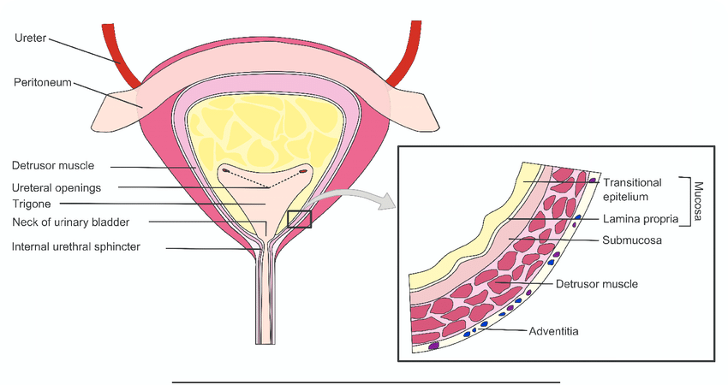
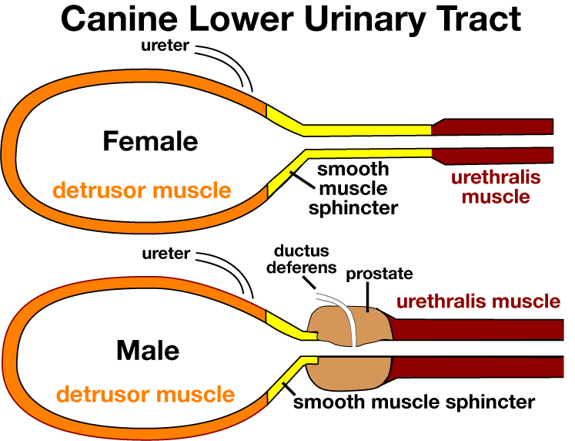
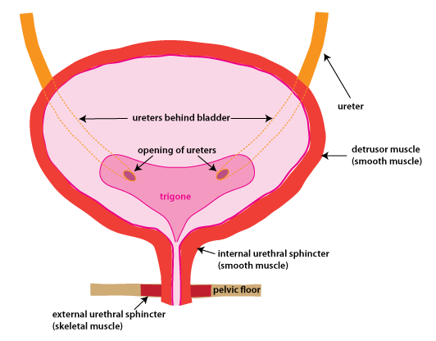
Urinary bladder

Slide 5
Cystotomy
Indication:
1- cystic calculi and urethral calculi
2- neoplasia
3- rupture of urinary bladder
4- repair of ectopic ureters
5- identification and biopsy of masses

